Slide 1

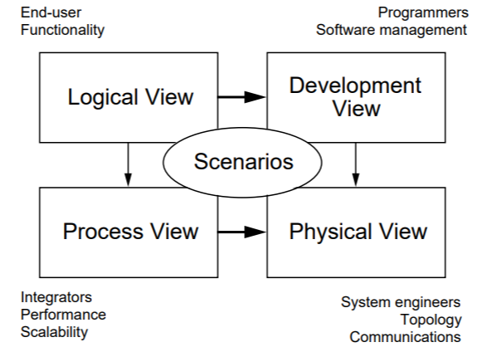
Documenting Architectures Quiz
https://bit.ly/4iPBeyh

